Slide 1
Academic Management System
GROUP MEMBERS :
Rahul Kumar ( IIT2019109)
Aditya Singh Machhaiya ( IIT2019111 )
Khushi Gupta ( IIT2019141 )
Nandini Gupta ( IIT2019149 )

Slide 2
About the project
Academic management system is a web based application.
The basic aim of this application is to provide easy and flexible application to maintain the details of the students.
Application of this project is to maintain the records of student like their Fee status, Semester results, subjects etc and the role of dean in our project is that they can see information, Result of any student and can change/view timetable and academic calendar.

Slide 3
Our Goals
The main goal of this software is to simplify the process of information management in a college.
1
It helps dean to manage the details of students like attendance record, fee status, marks, course enrolled etc.
2
Students can see their details and time table, calendar etc.
3
It has simple user interface. Thus it helps both students and dean to access the details very quickly.
4

Slide 4
Work Distribution among each member
Aditya (IIT2019111) :- Backend connection,DB work, Documentation
Rahul (IIT2019109) :- DB work, Backend connections, Documentation
Nandini (IIT2019149) :- Front end work, System testing, Documentation
Khushi (IIT2019141) :-UI/UX Design, System testing, Documentation

Slide 5







Tech stack used
Frontend
Backend

Slide 6
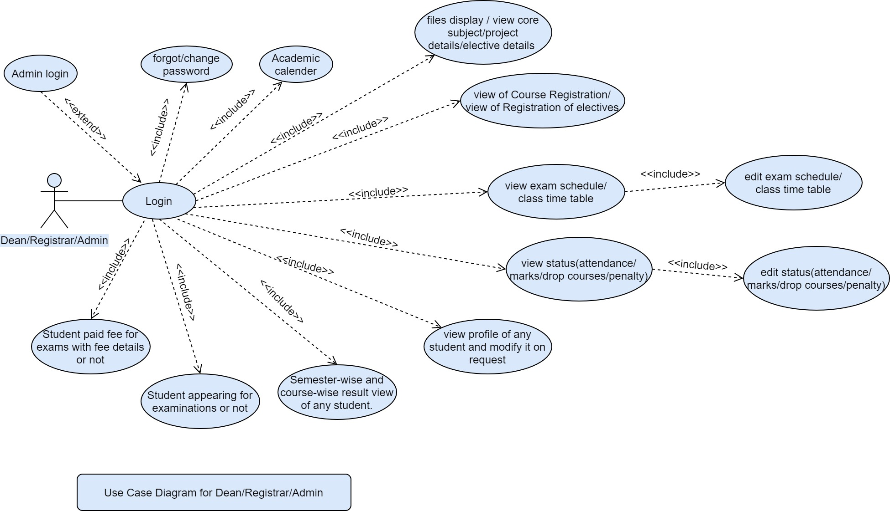
SRS - Use Case Diagram
Dean OR Admin

Slide 7
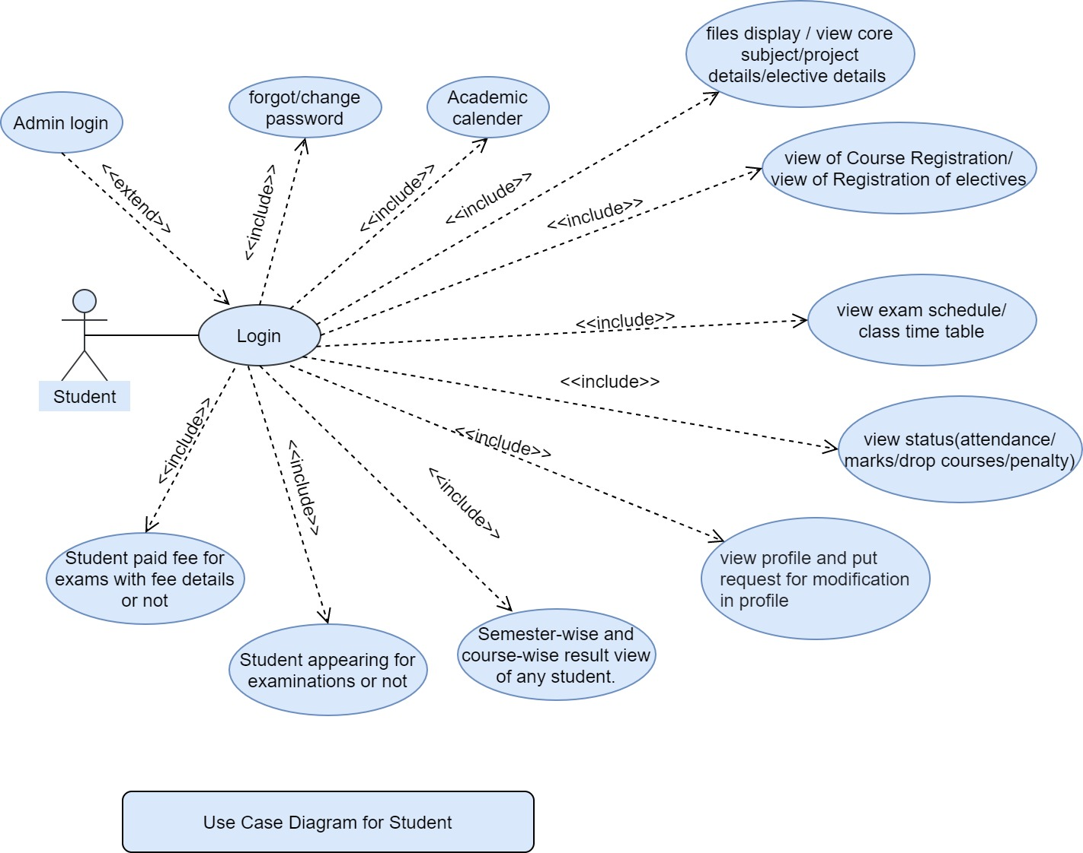
SRS - Use Case Diagram
Student

Slide 8
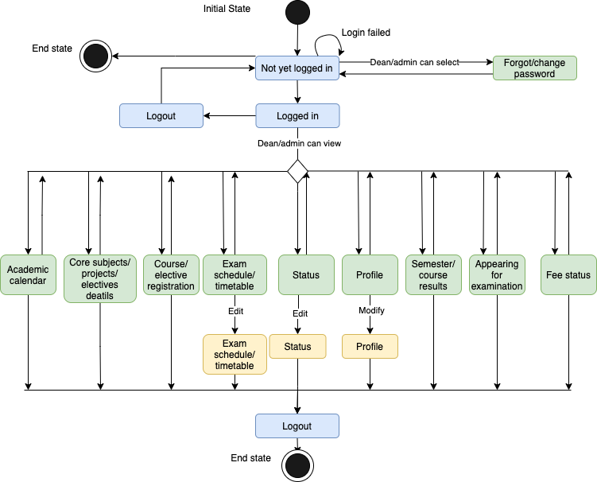
SDS - State Diagram
Dean OR Admin

Slide 9
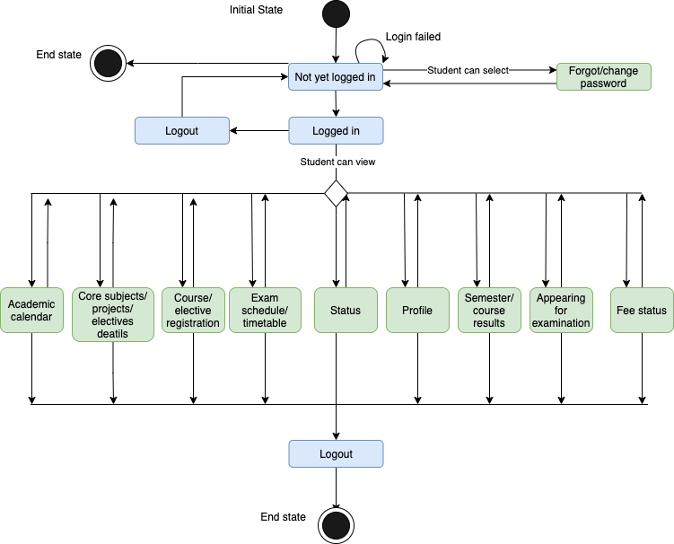
SDS - State Diagram
Student

Slide 10
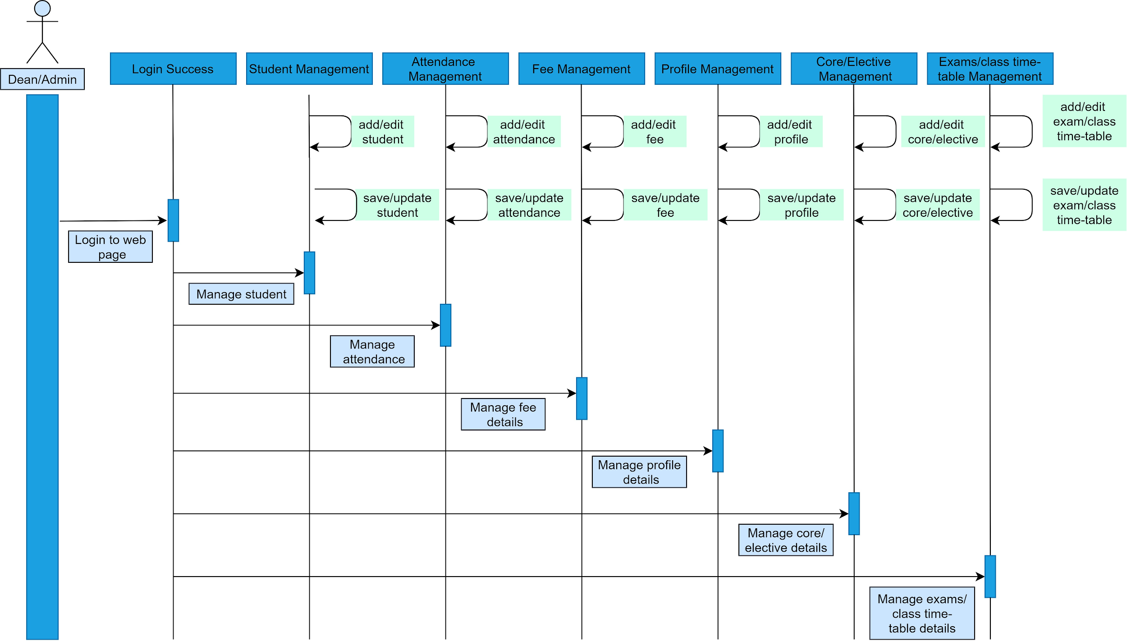
SDS - Sequence Diagram
Dean OR Admin

Slide 11
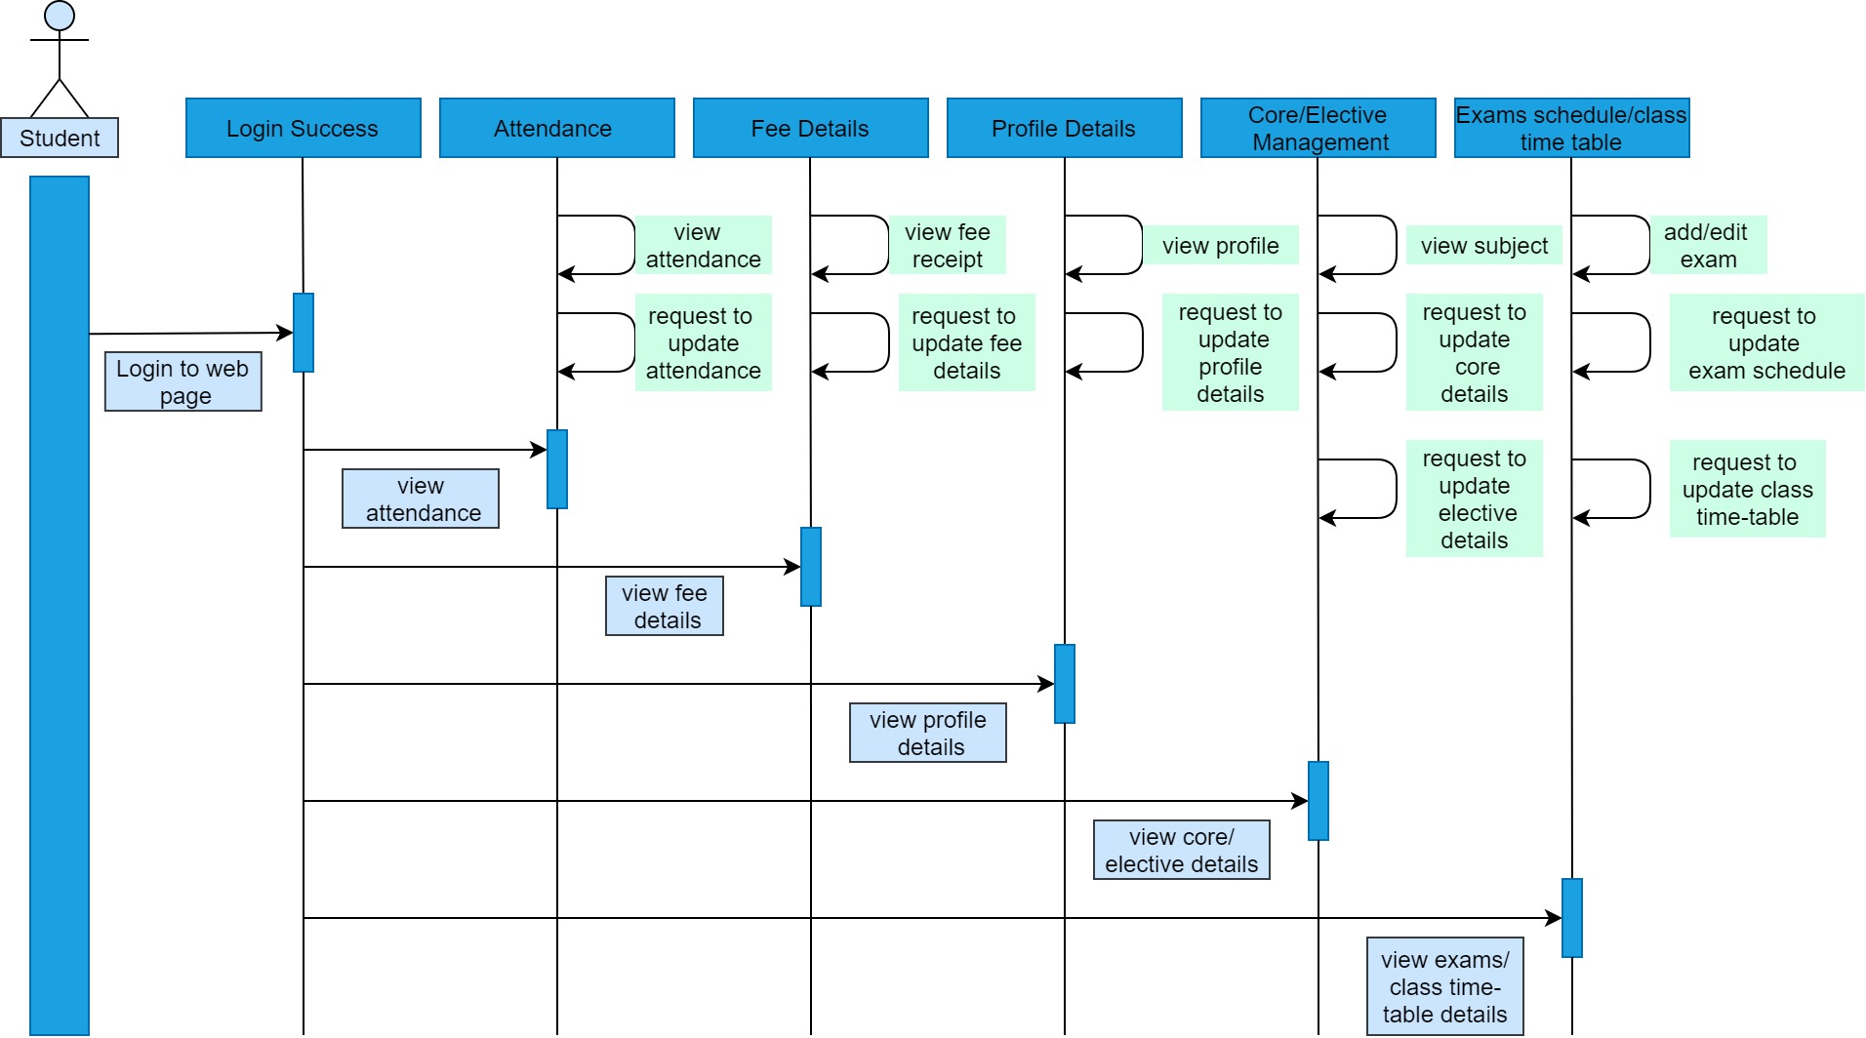
SDS - Sequence Diagram
Student

Slide 12
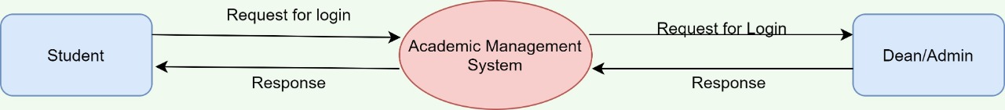
SDS - Data Flow Diagram
Level -0

Slide 13
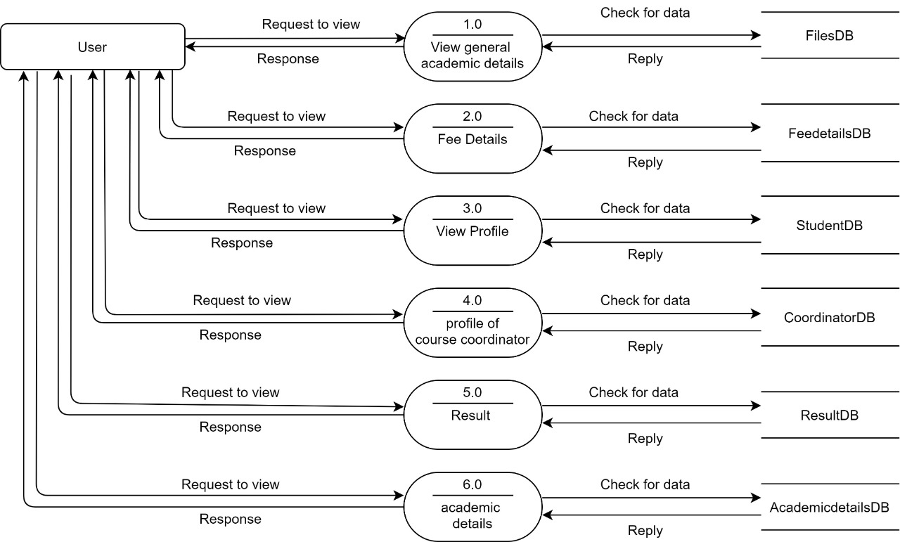
SDS - Data Flow Diagram
Level - 1

Slide 14
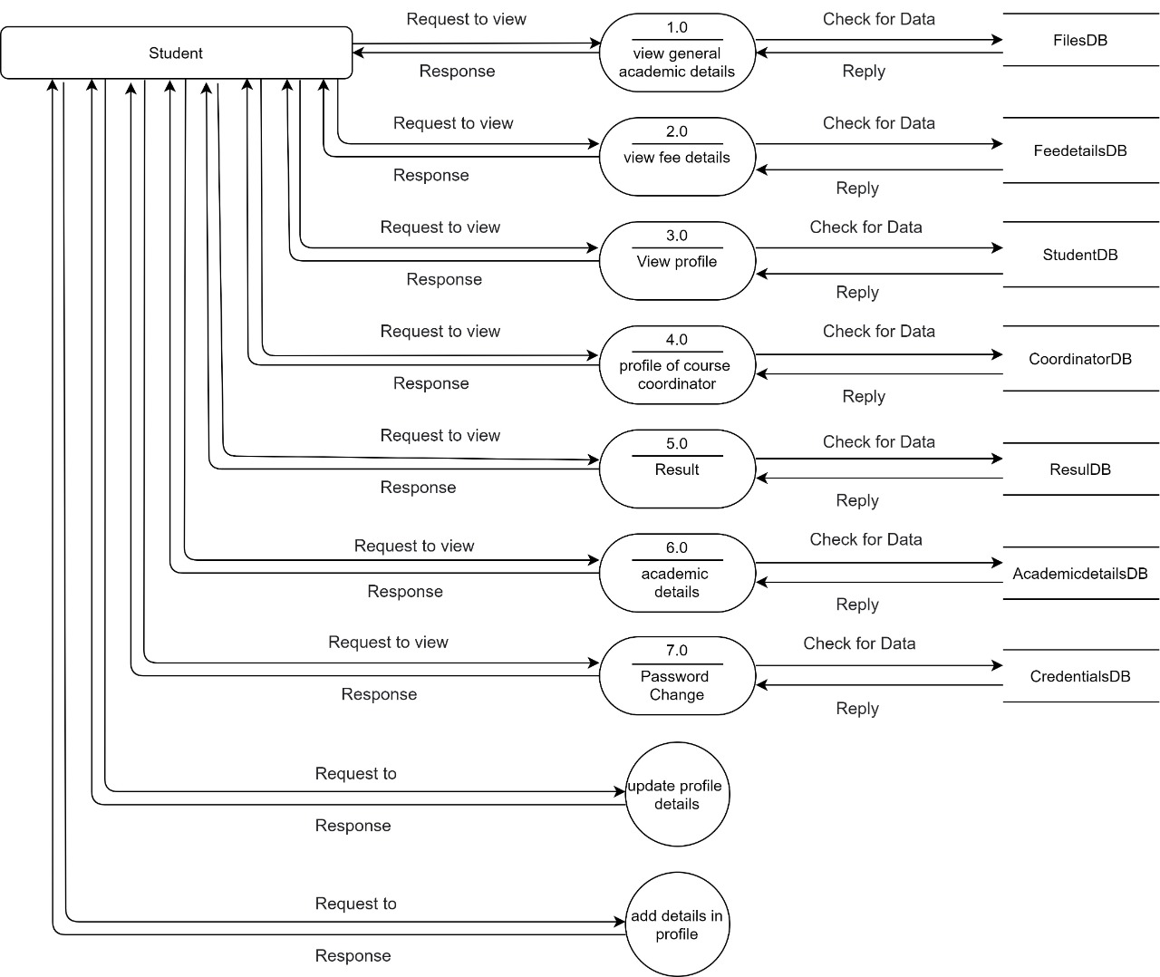
SDS - Data Flow Diagram
Level - 2
Student

Slide 15
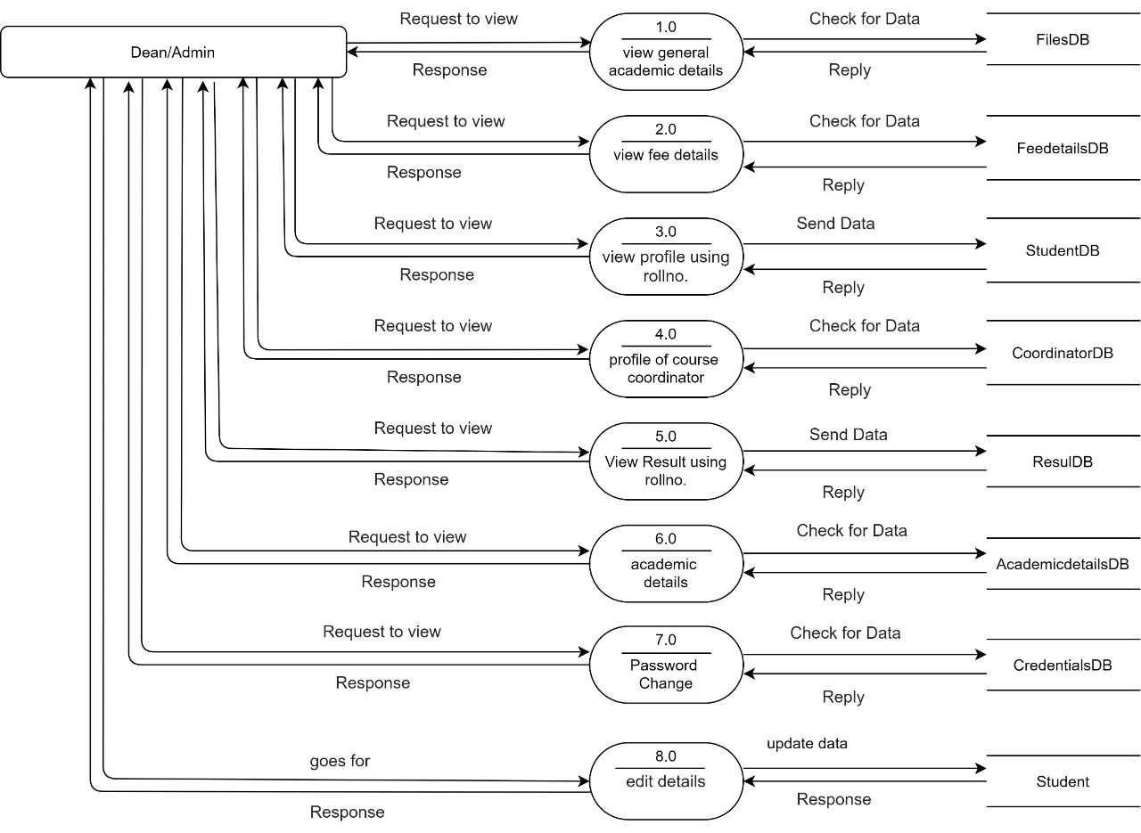
SDS - Data Flow Diagram
Level - 2
Dean OR Admin

Slide 16
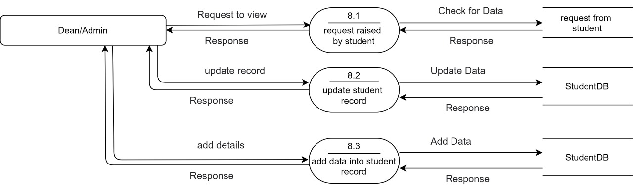
SDS - Data Flow Diagram
Level - 2
Dean OR Admin

Slide 17
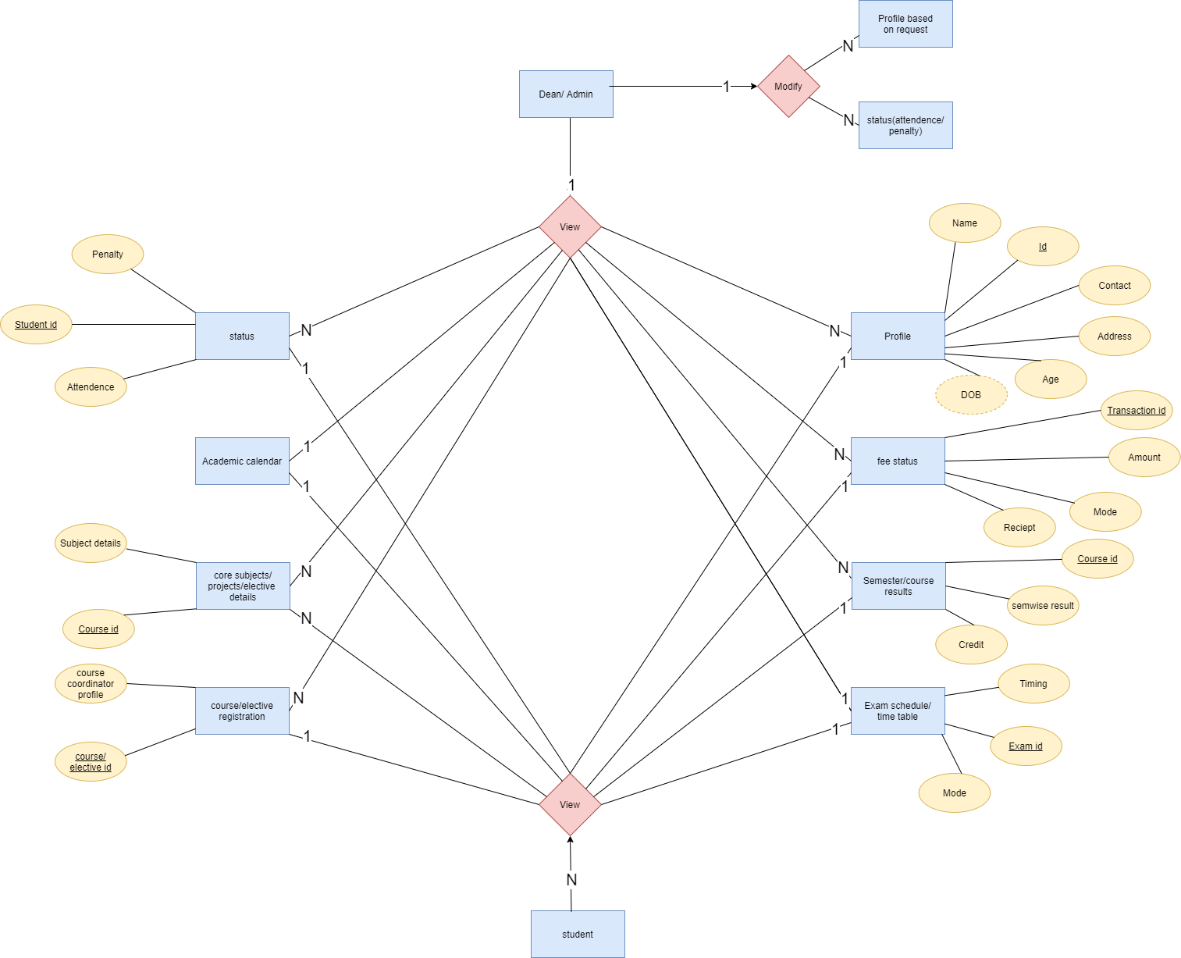
SDS - Entity Relationship Diagram

Slide 18
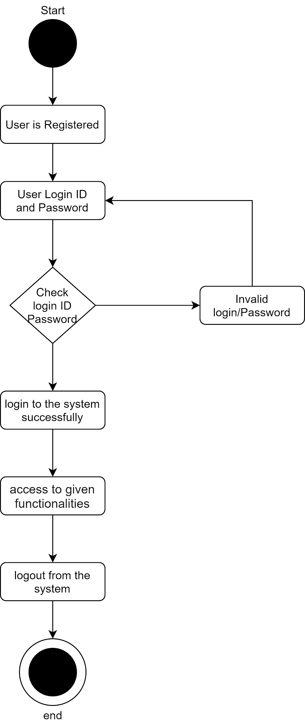
SDS - Activity Diagram
Login Activity Diagram

Slide 19
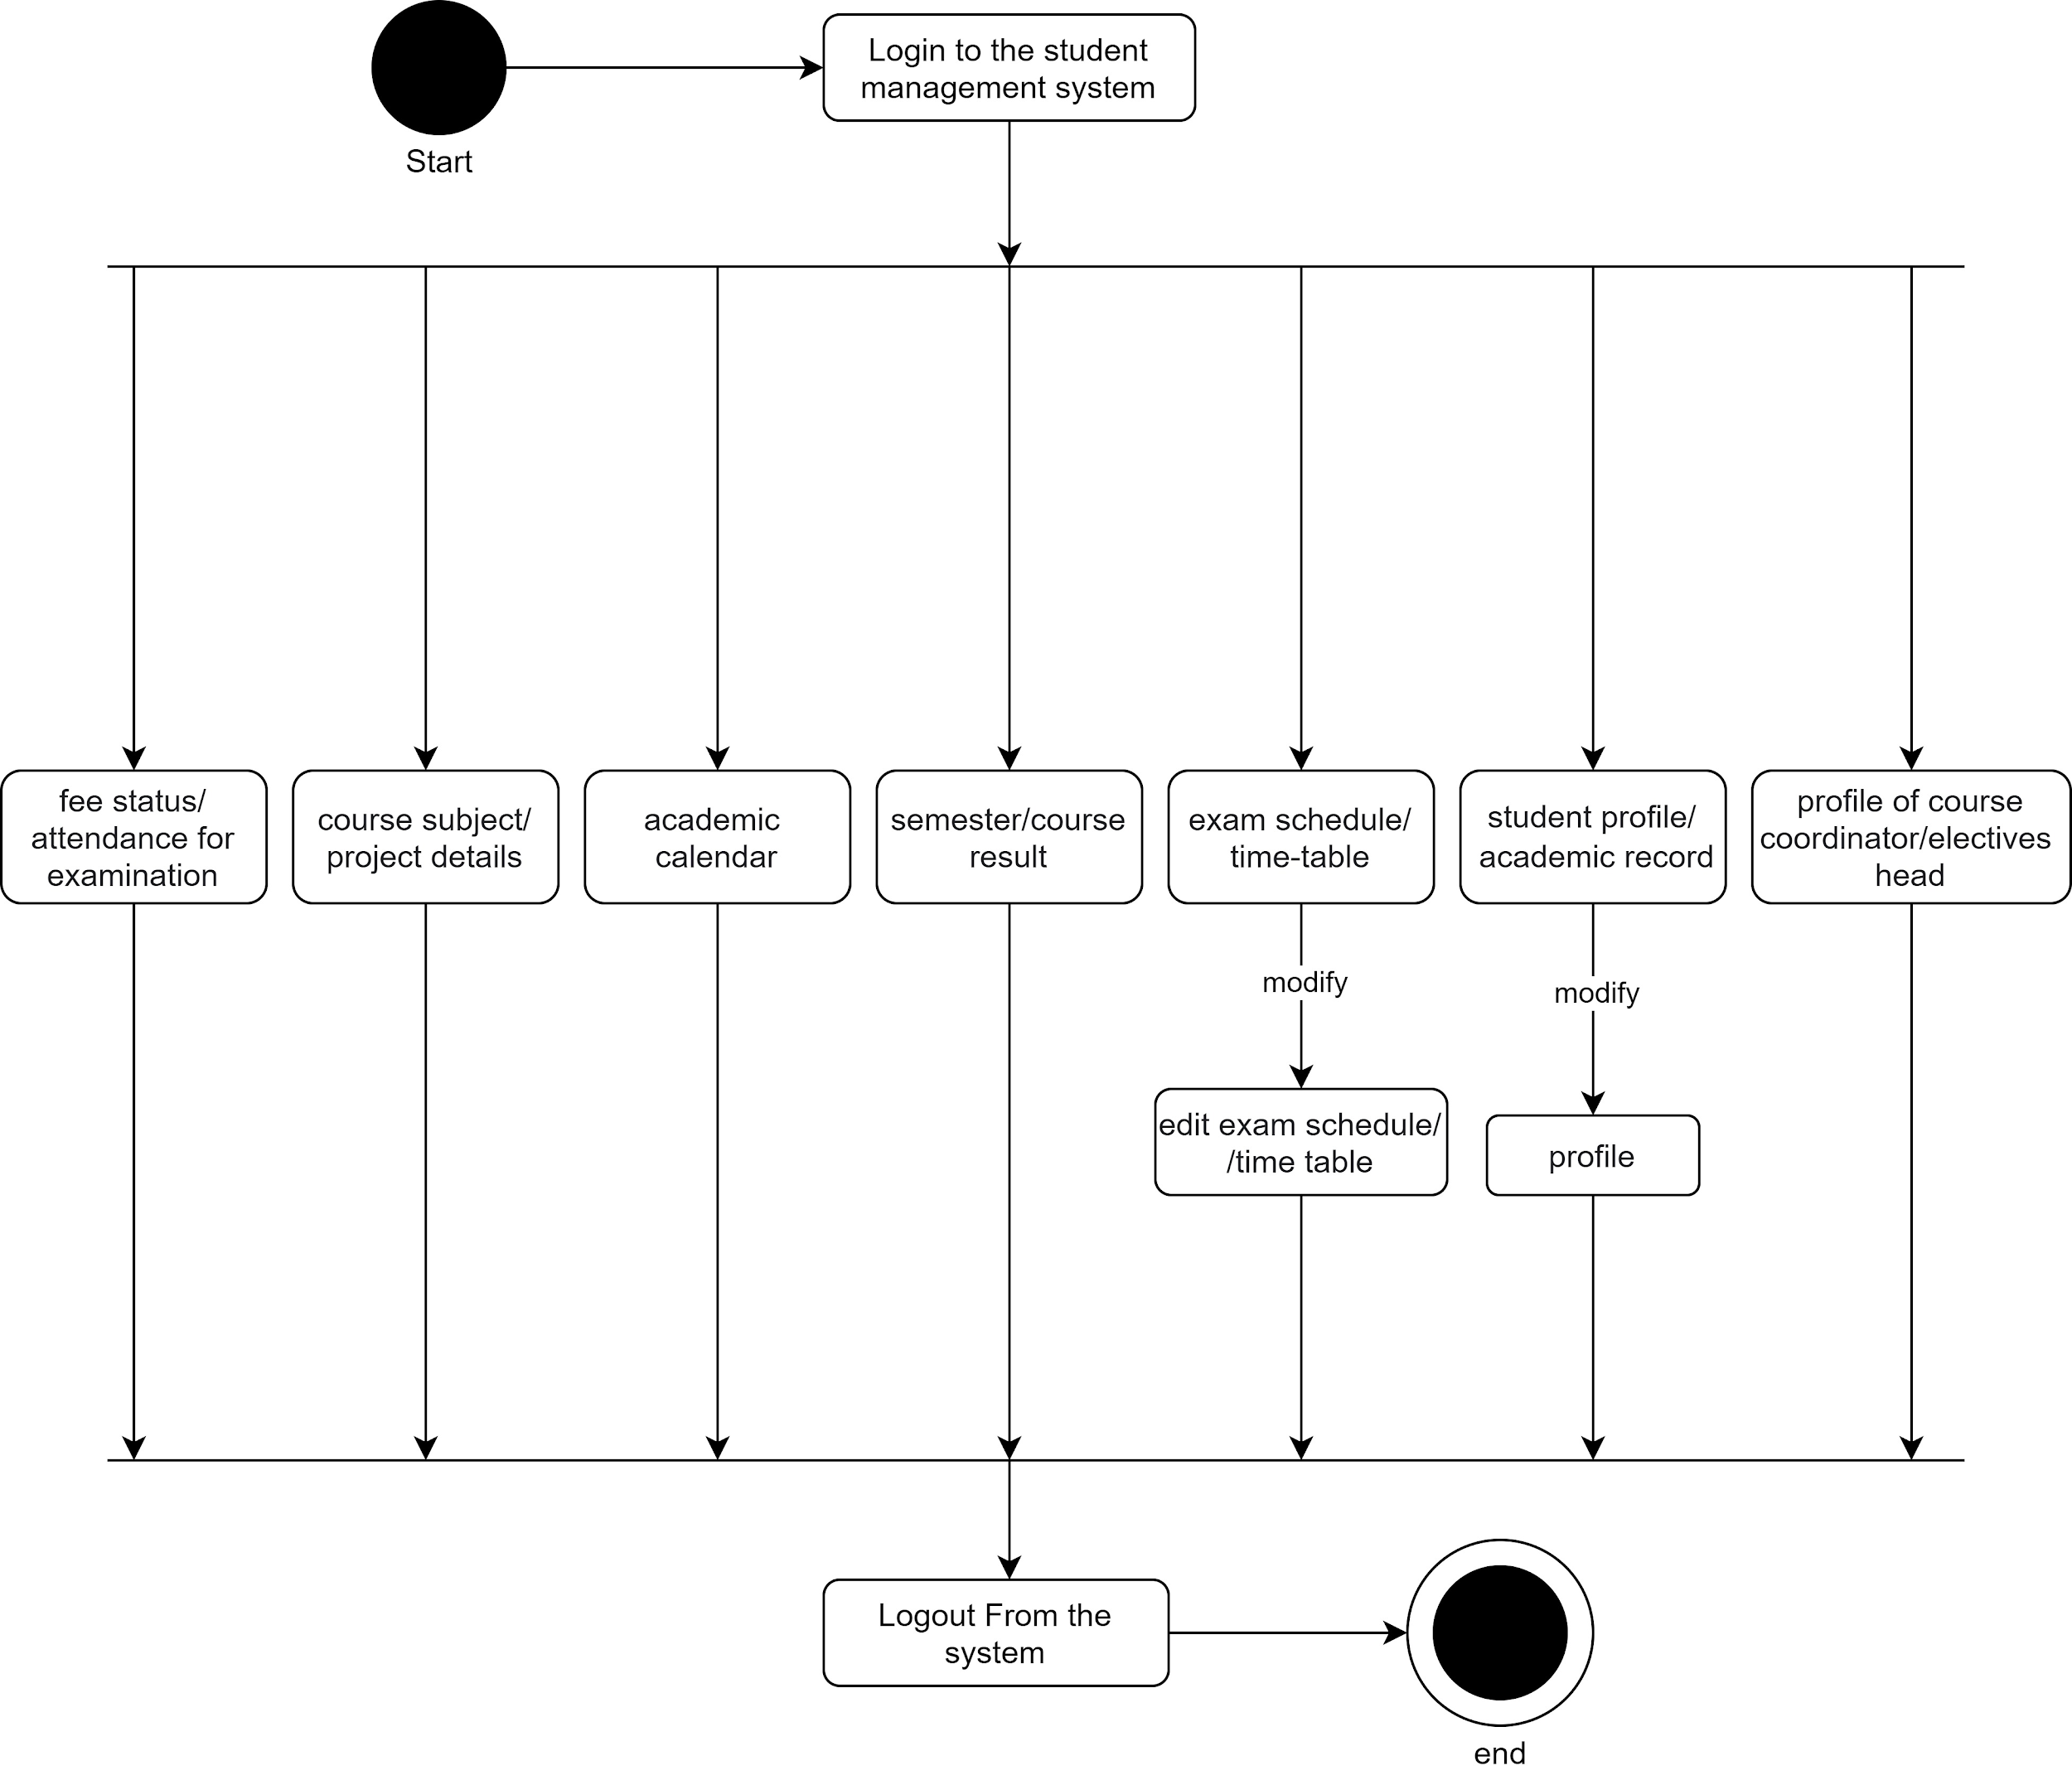
SDS - Activity Diagram
Dean OR Admin

Slide 20
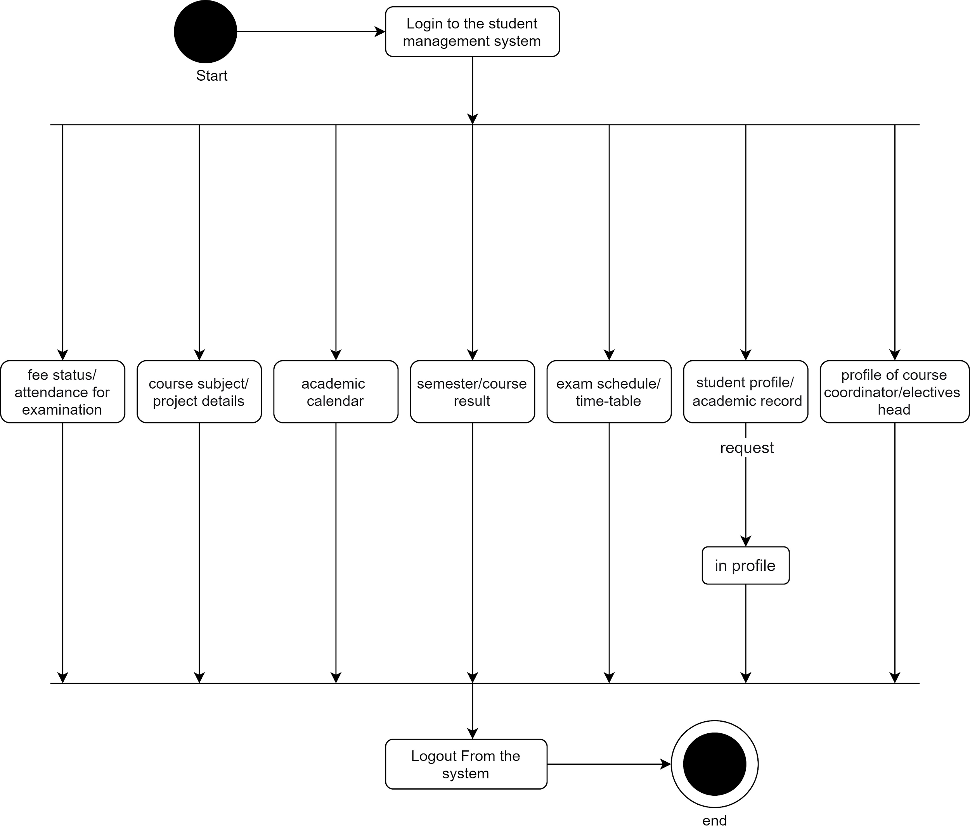
SDS - Activity Diagram
Student

Slide 21
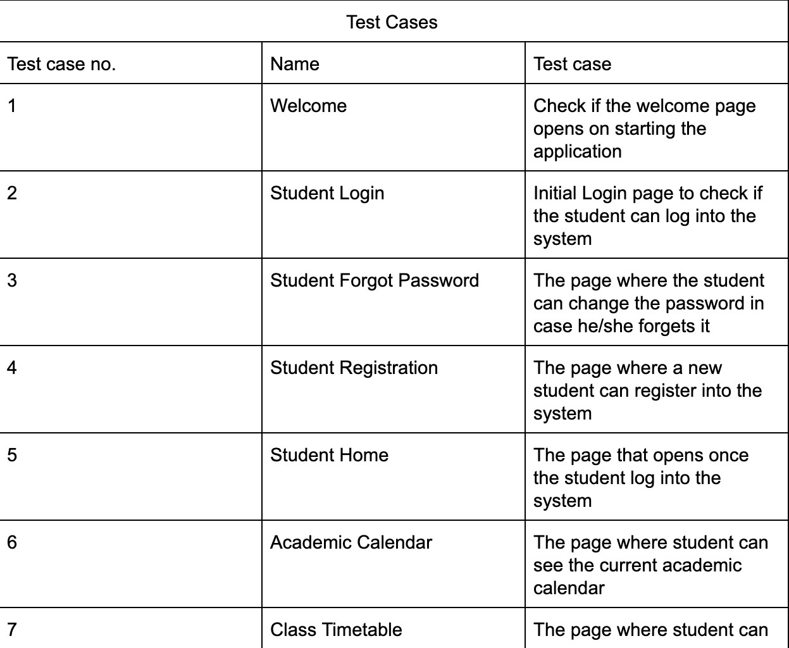
Test Plan

Slide 22
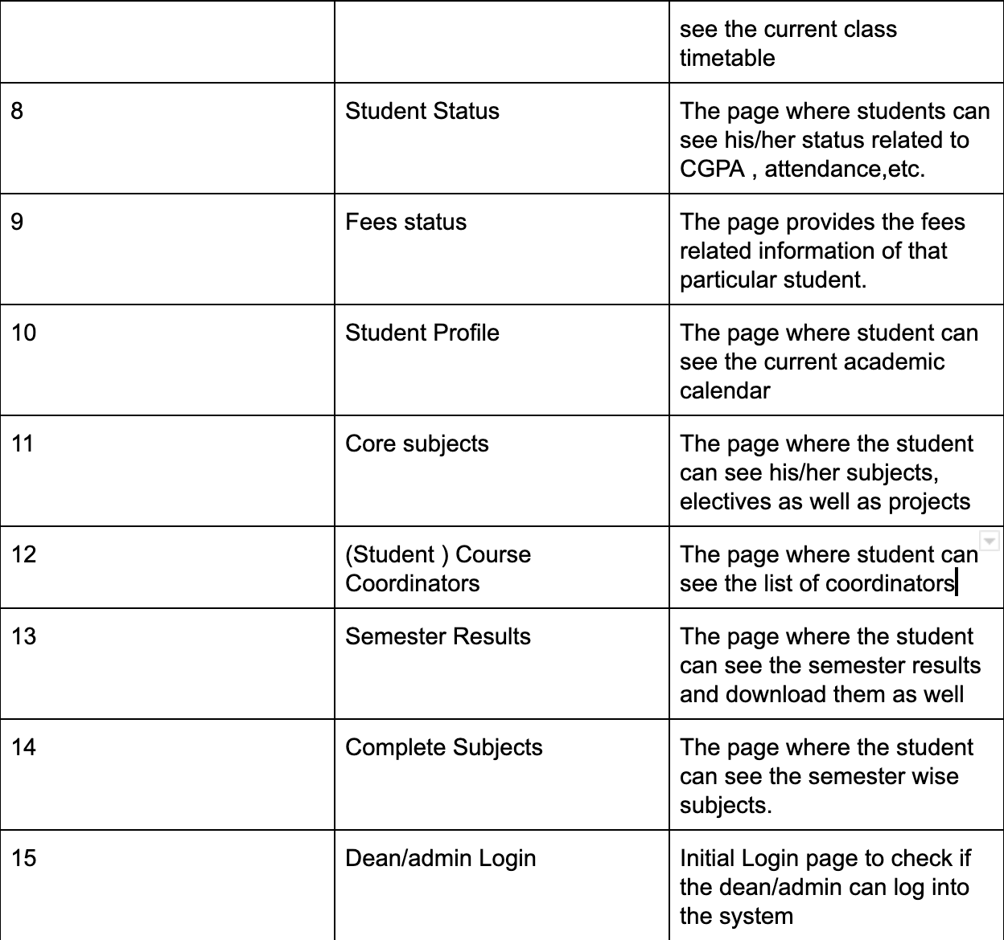
Test Plan

Slide 23
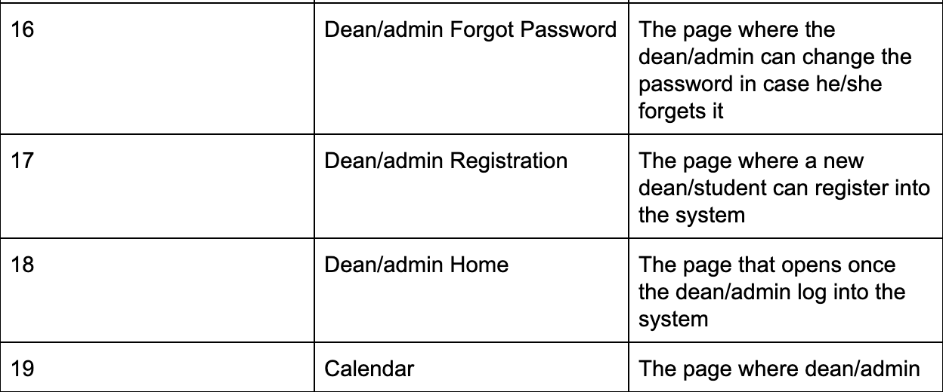
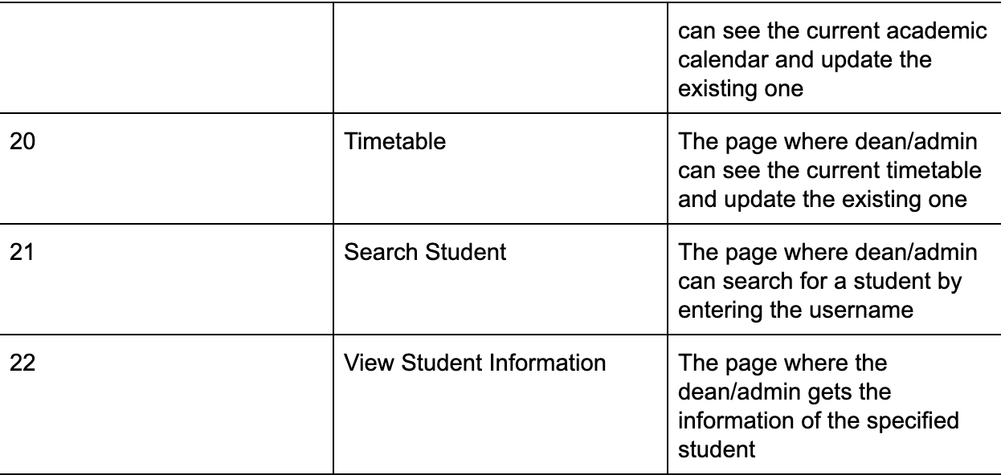
Test Plan

Slide 24
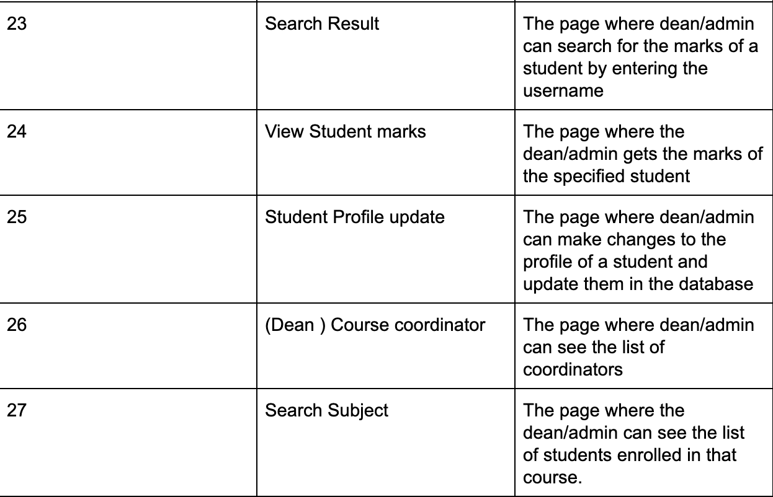
Test Plan

Slide 25
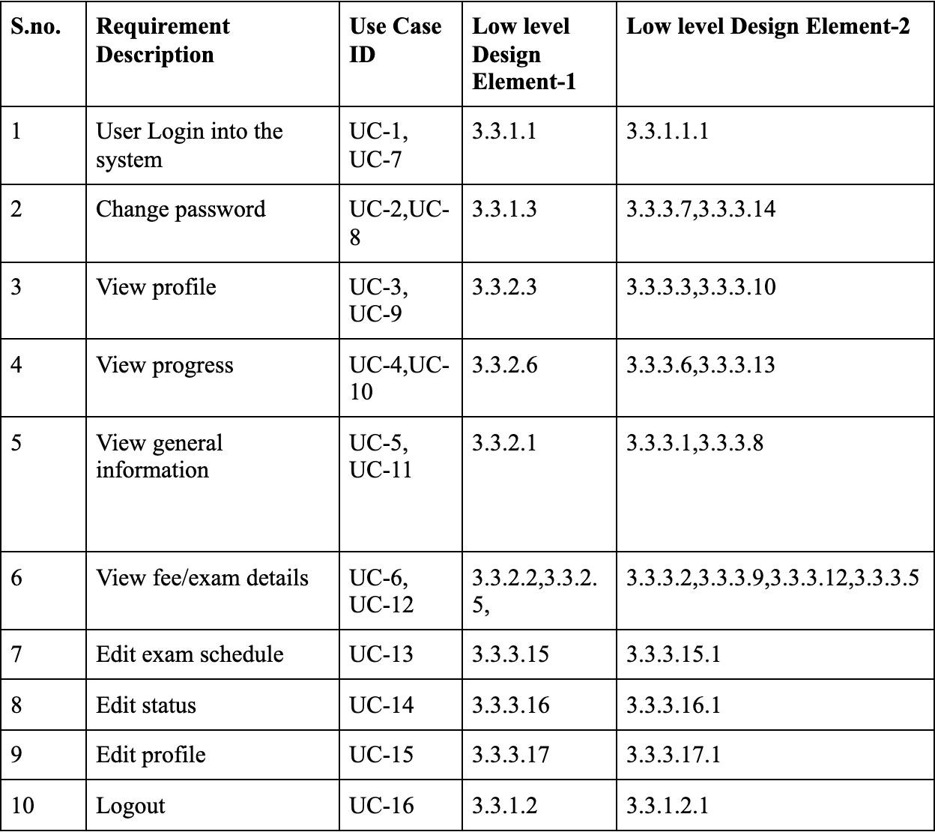
TRACEABILITY MATRIX
SRS and SDS

Slide 26
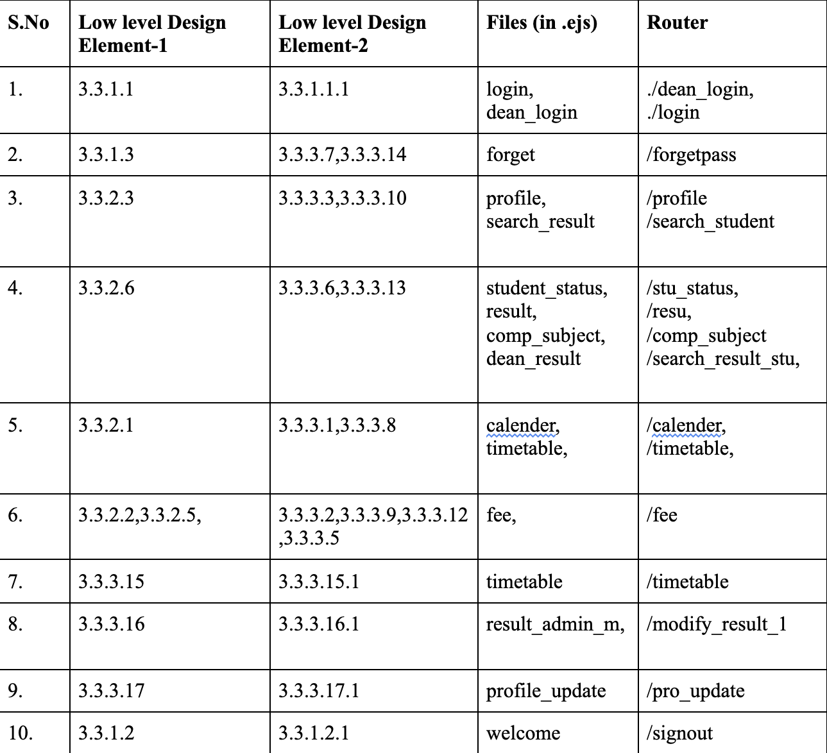
TRACEABILITY MATRIX
SDS and code

Slide 27
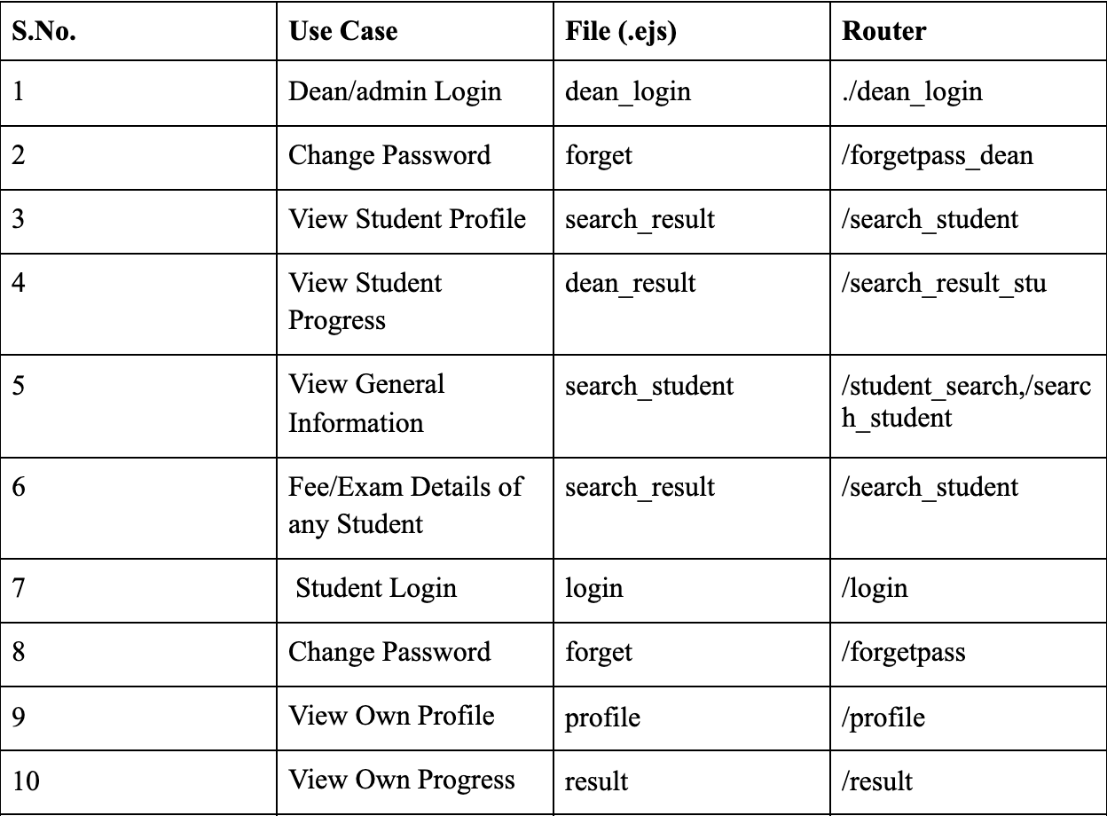
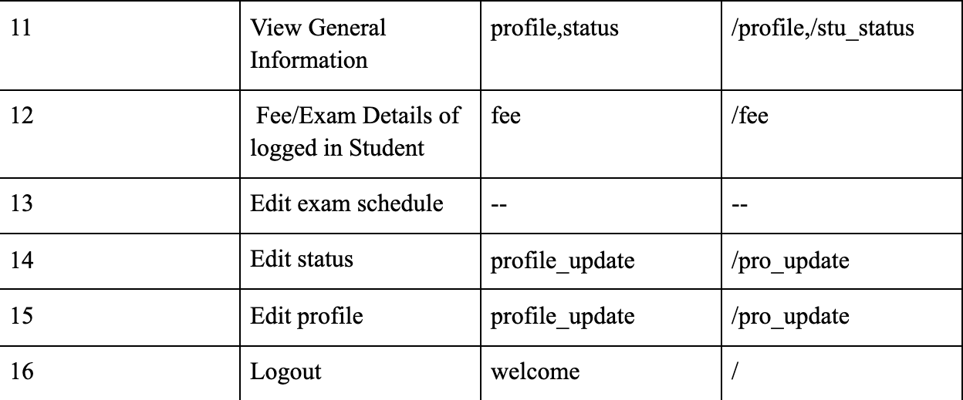
TRACEABILITY MATRIX
SRS and Code

Slide 28
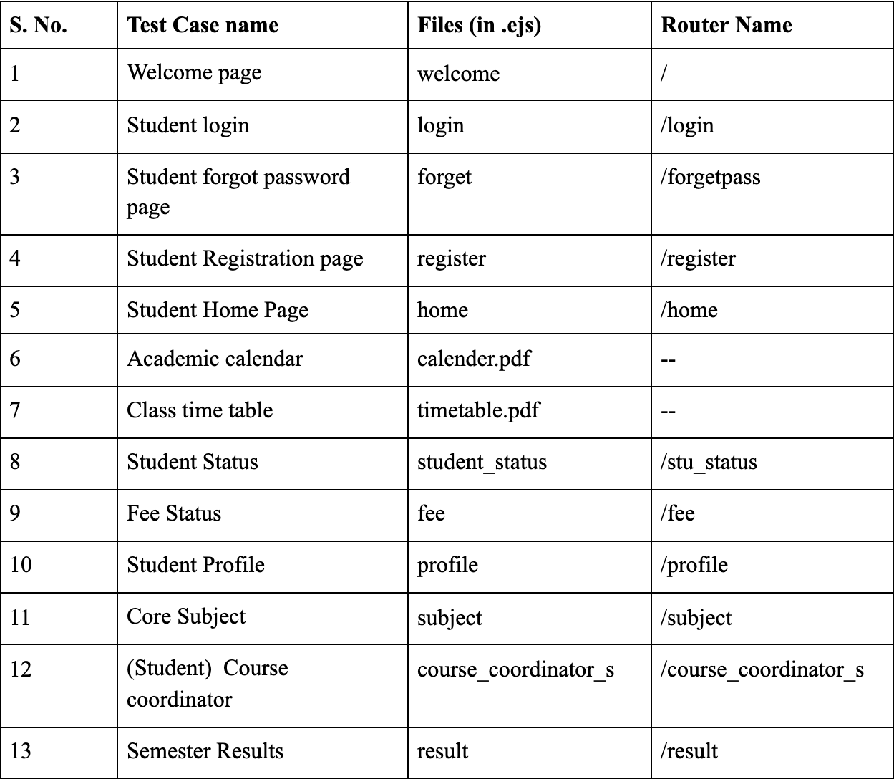
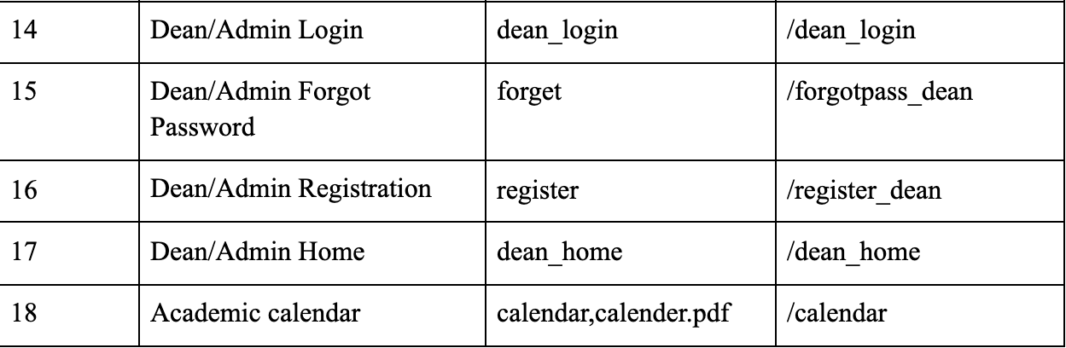
TRACEABILITY MATRIX
Code and Test Case

Slide 29

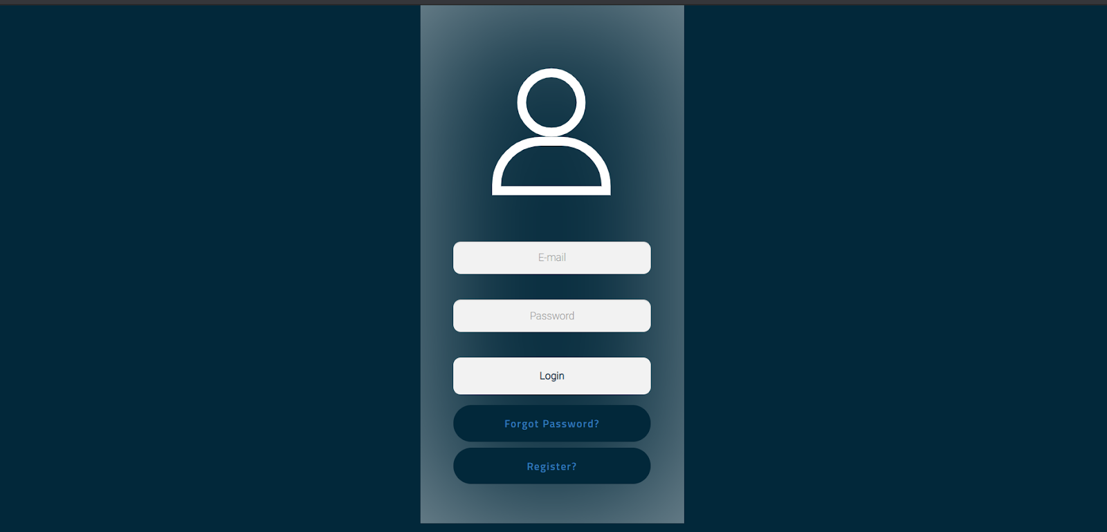
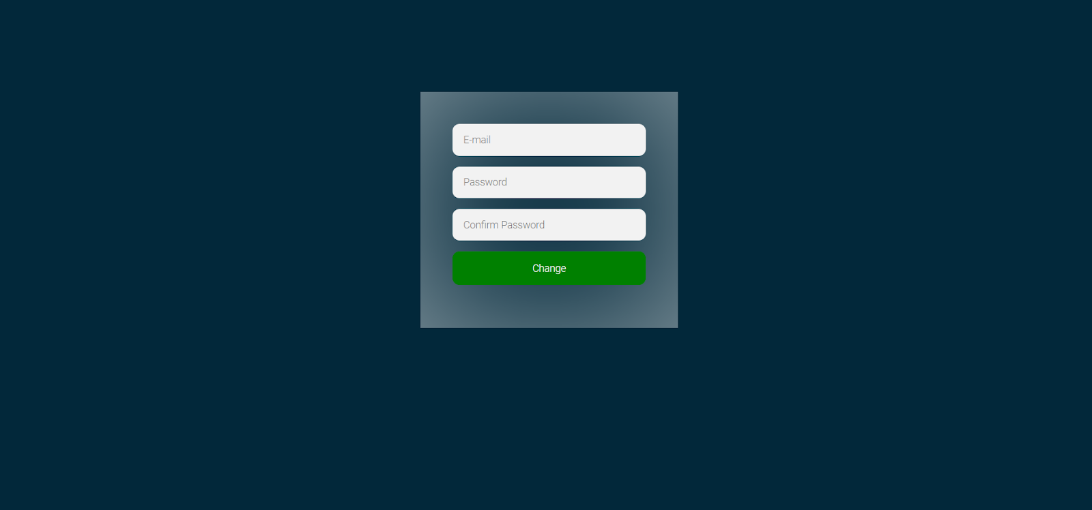
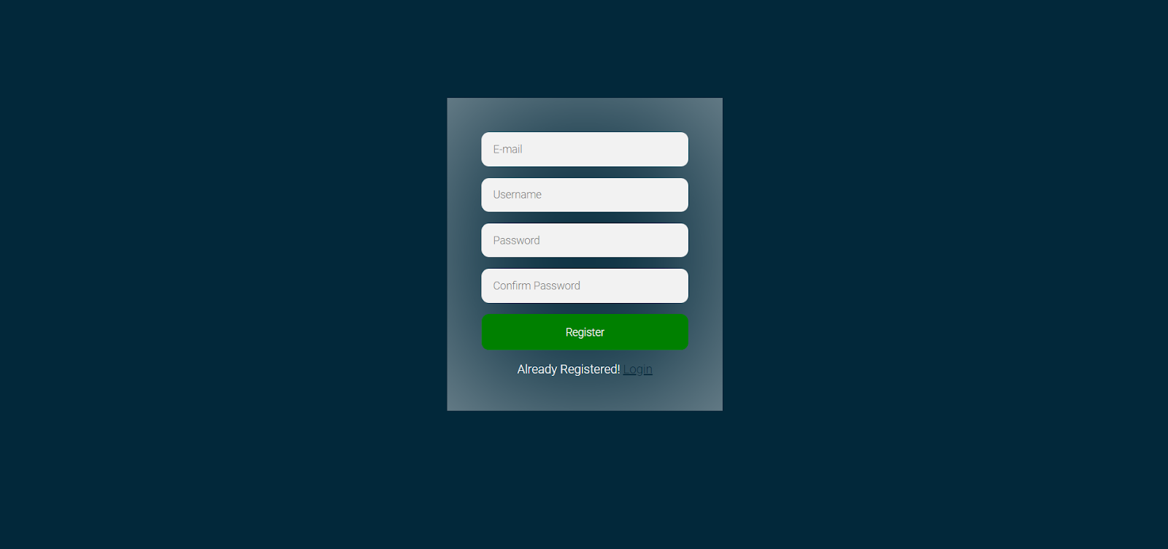
Screens
Welcome
Login
Change Password
Register

Slide 30
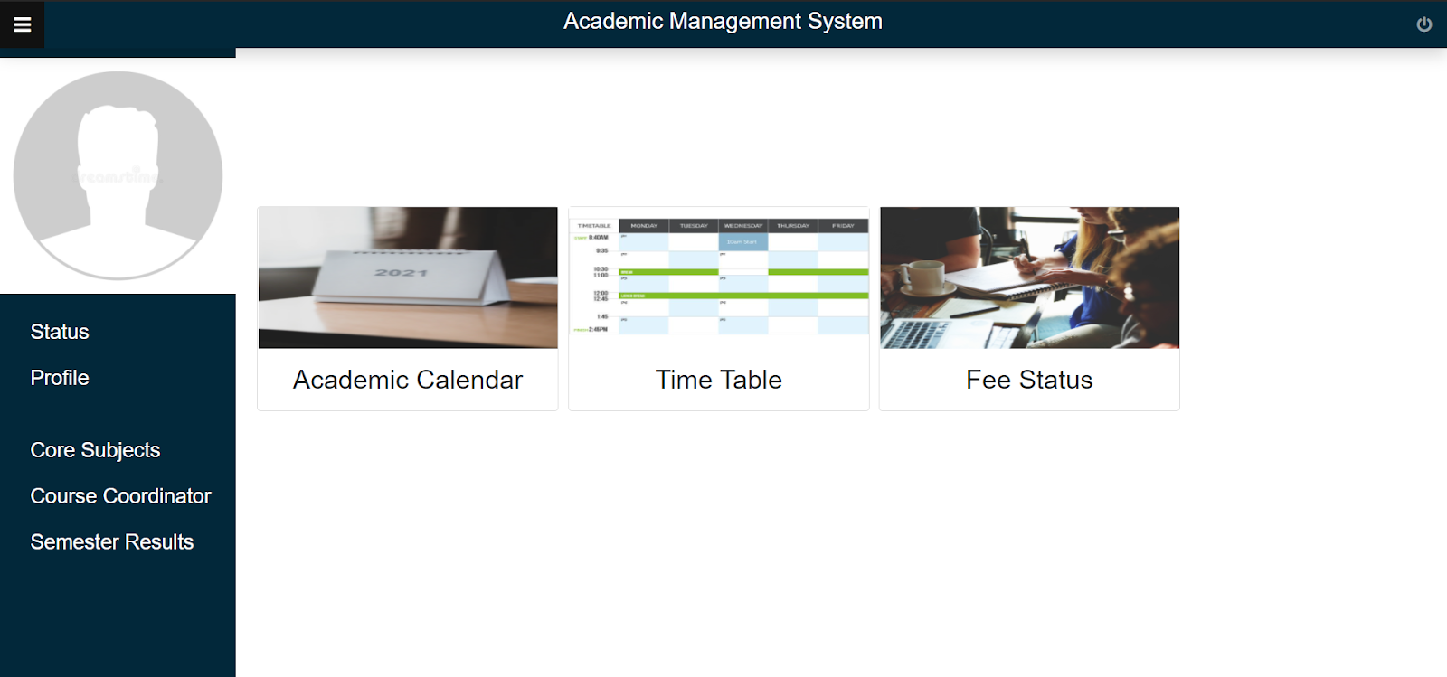
Home page for student
This is the home page for the student where they can see their academic calendar, Timetable, Fee status, Profile, Status, Subjects, Course Coordinators and Results.

Slide 31
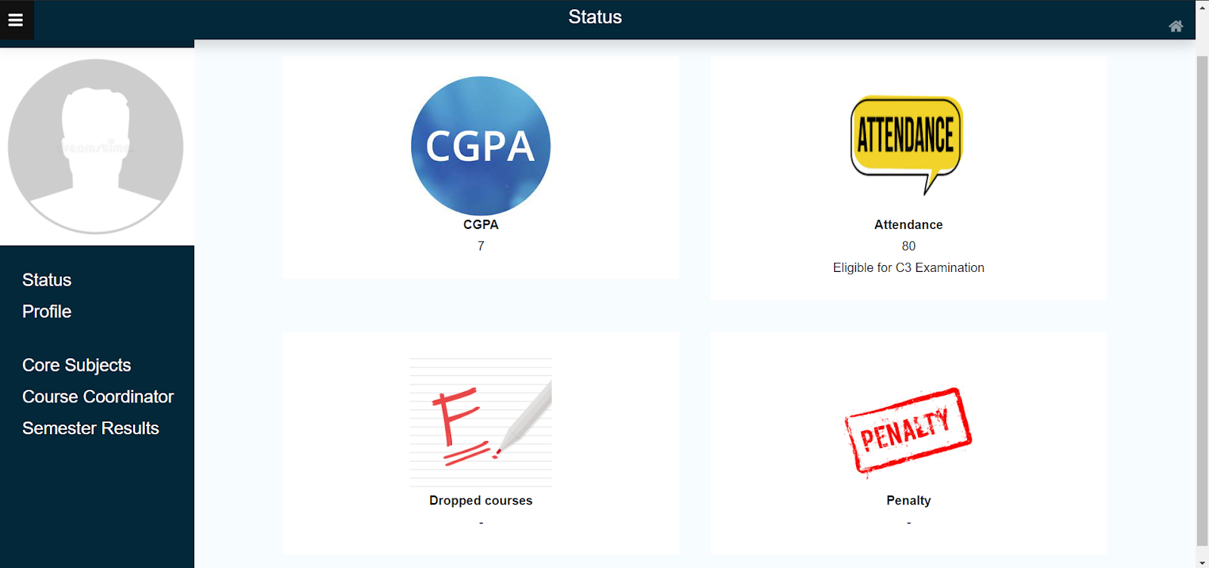
Student’s Status

Slide 32
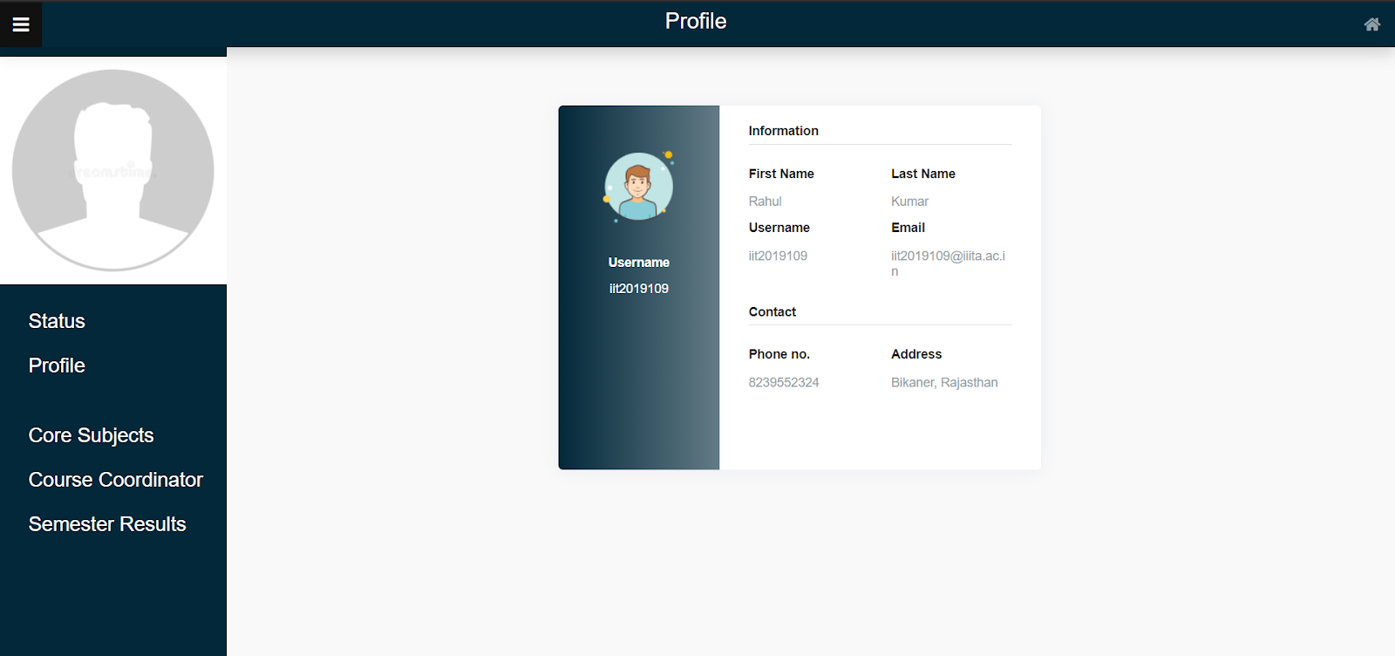
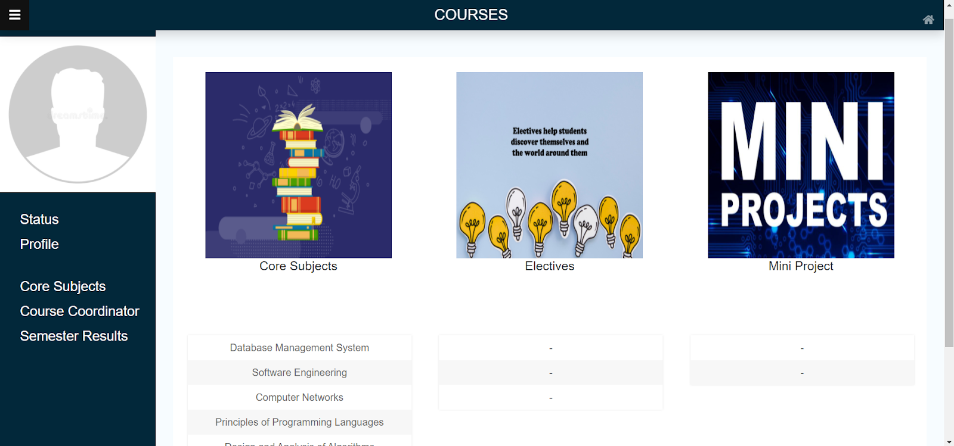
Student’s Profile
Core subjects
Contains General Information of the Student.
This page contains Information of the Subjects, Electives and Projects.

Slide 33
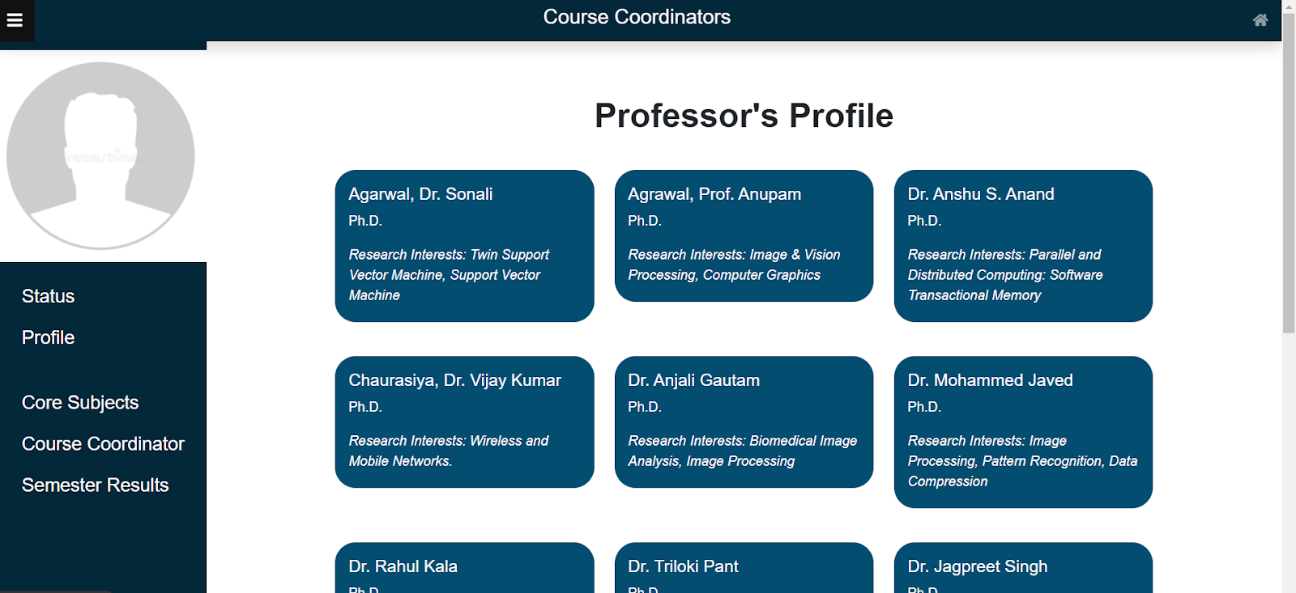
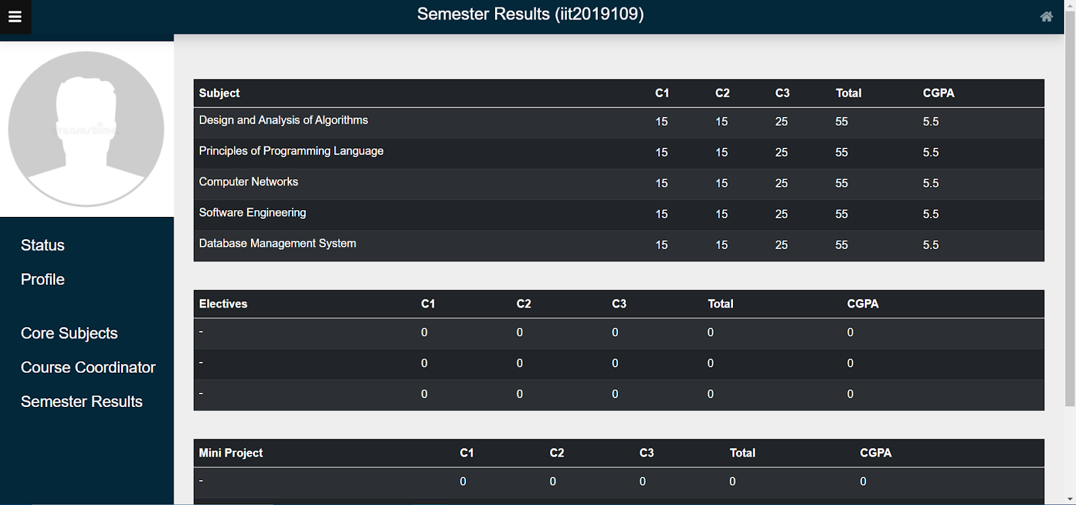
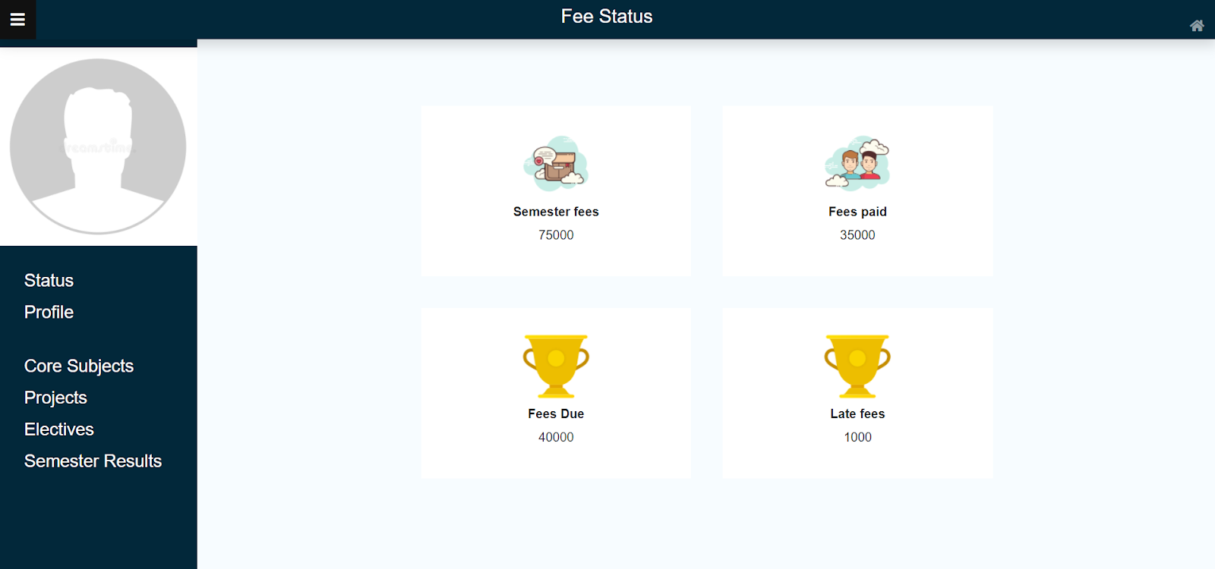
Course Coordinators
Semester Results
Fee Status

Slide 34
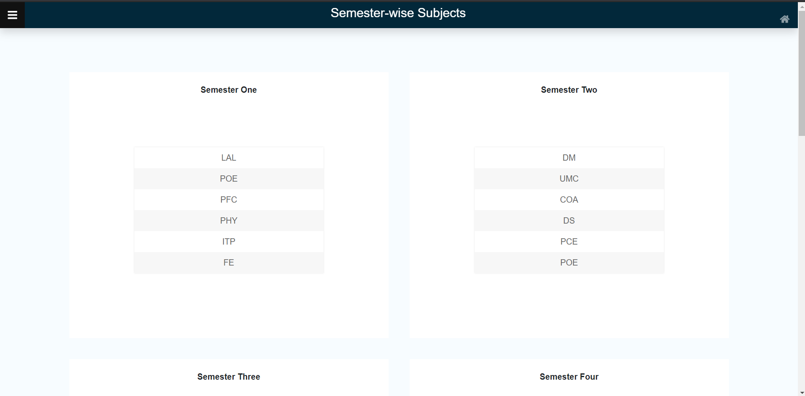
Semester-wise Subjects

Slide 35

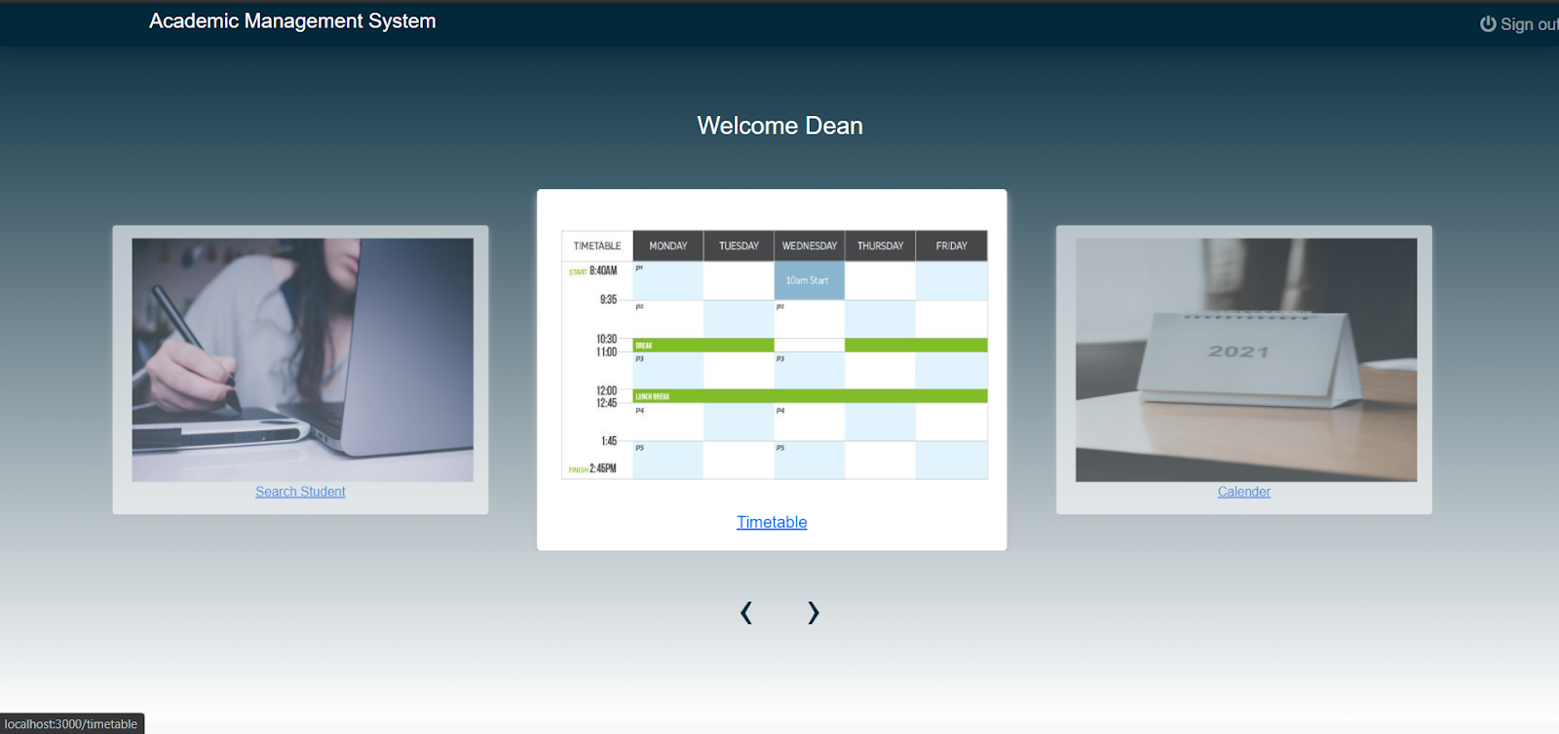
For Dean
Login
Home Screen

Slide 36
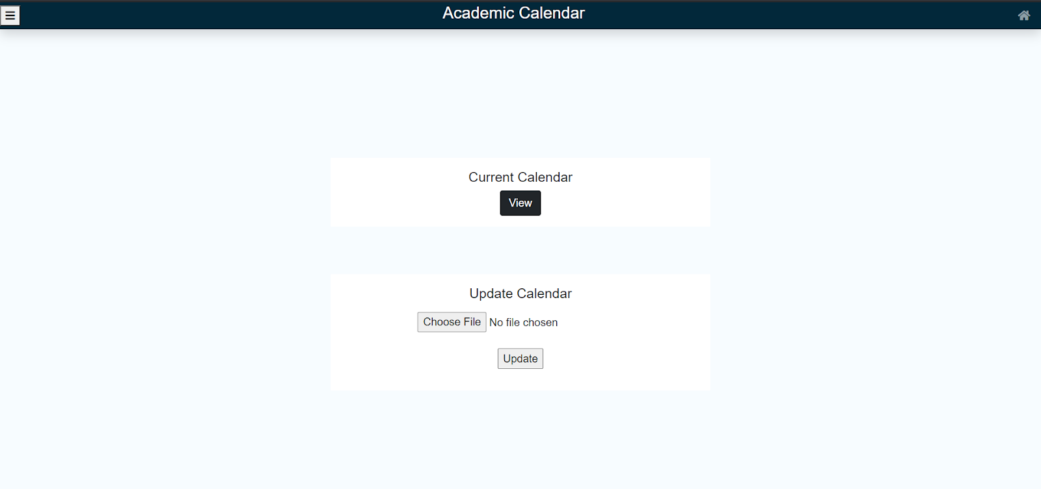
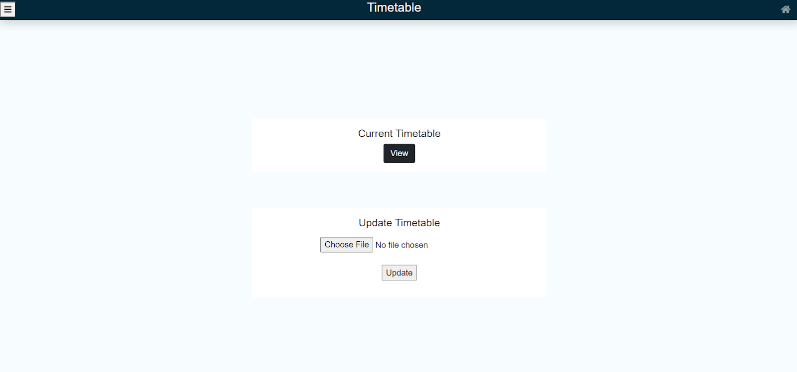
View/Update Calendar
View/Update Timetable

Slide 37
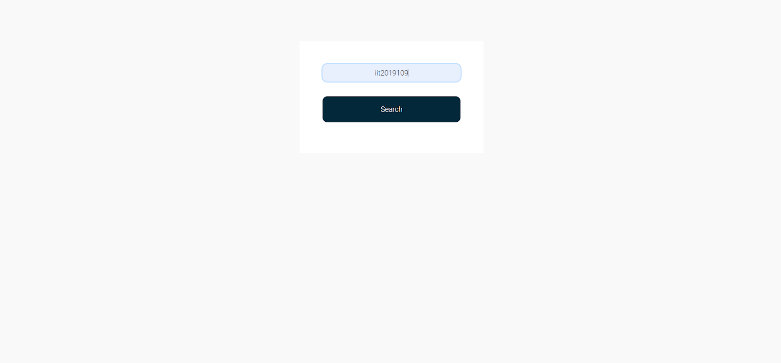
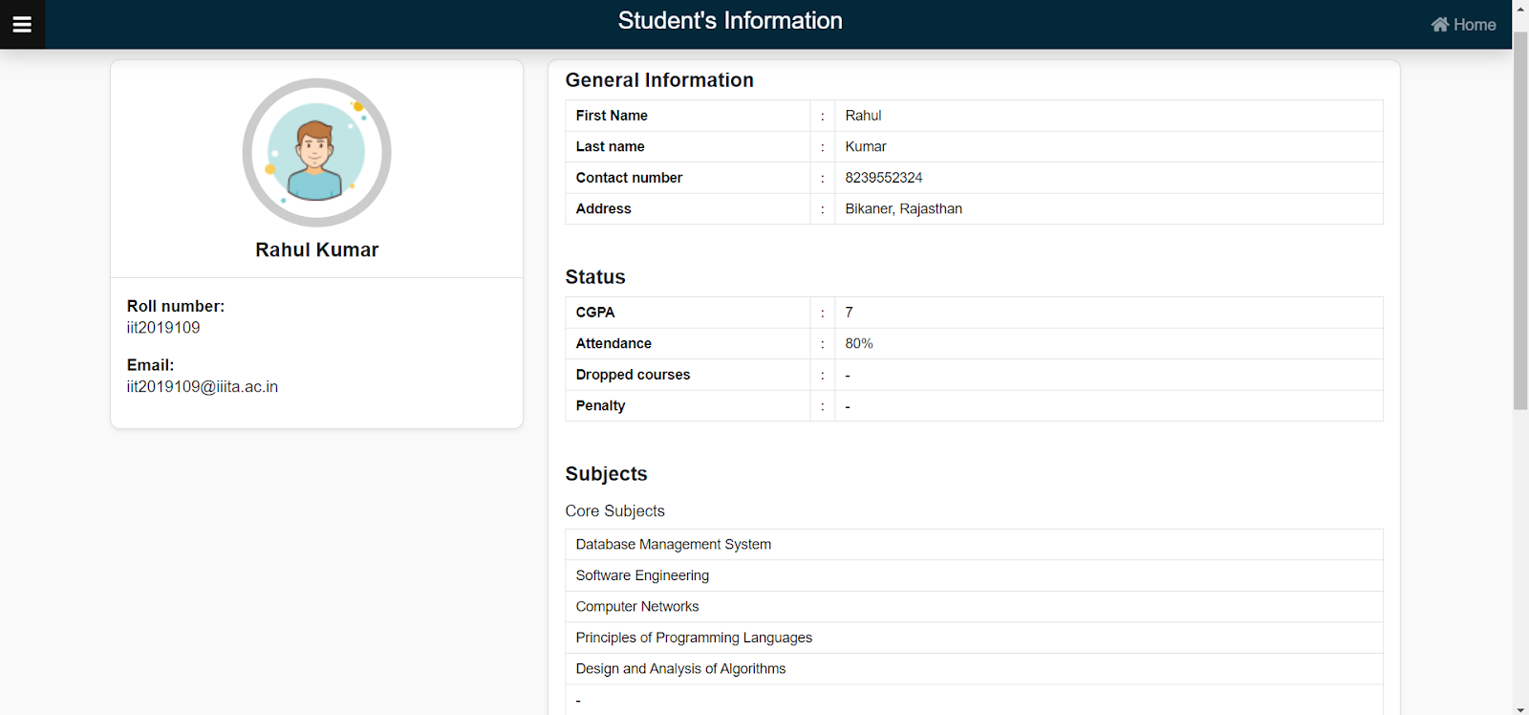
Search Student and can see information of that student

Slide 38
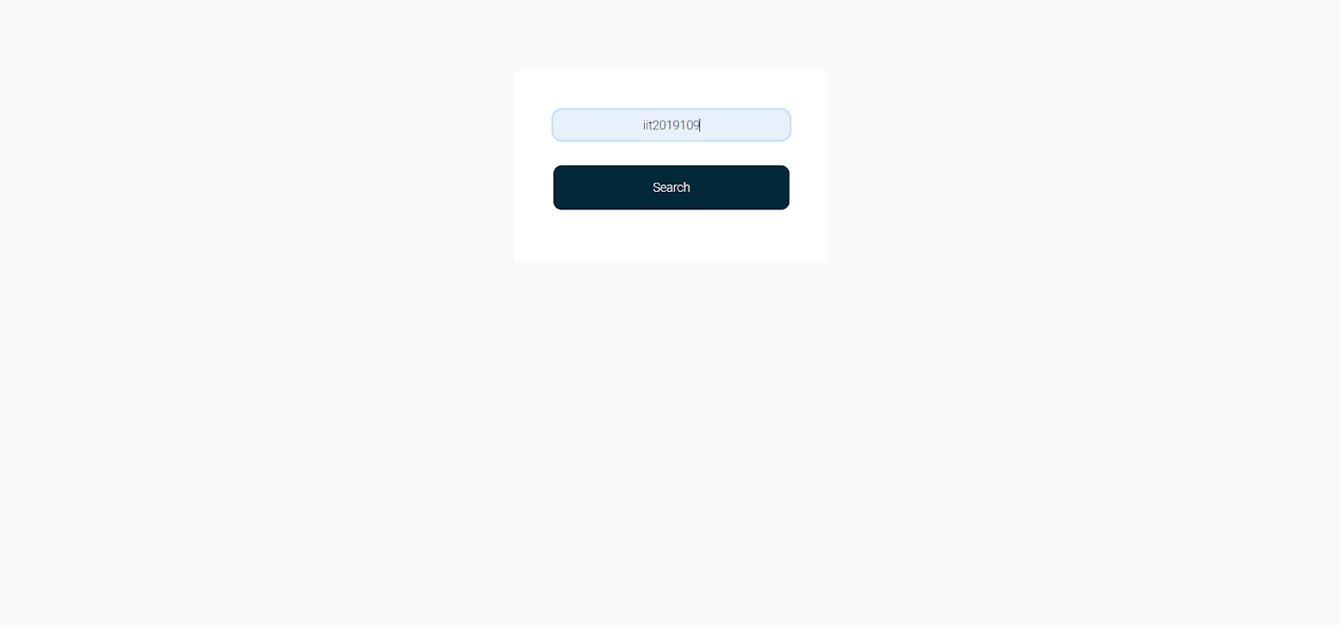
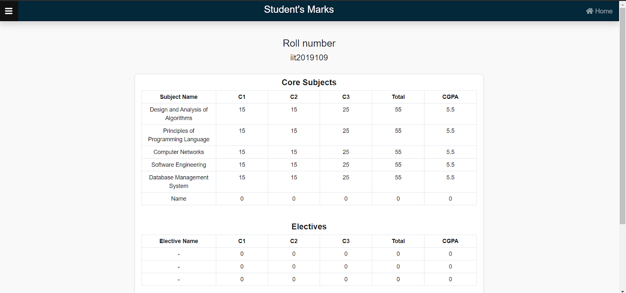
Search any student and can see result of that student

Slide 39
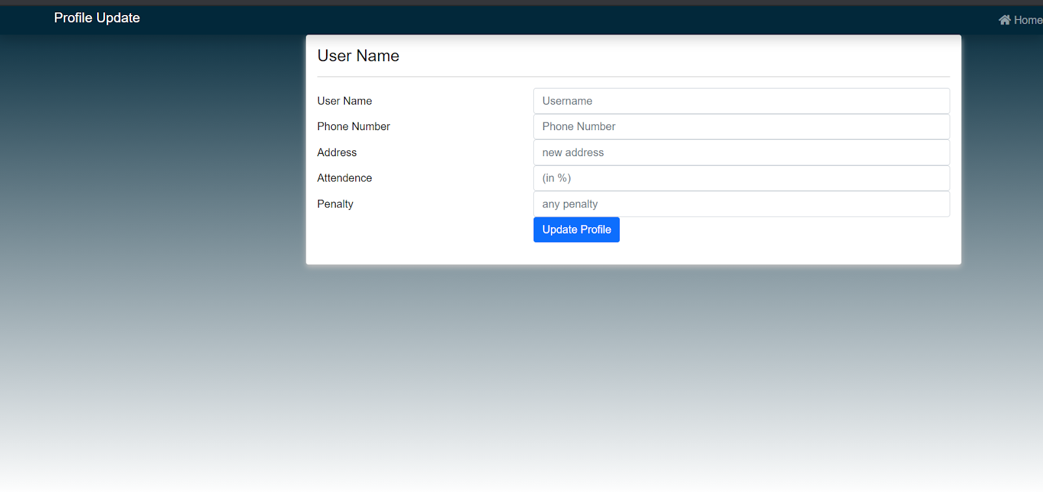
Update Profile

Slide 40
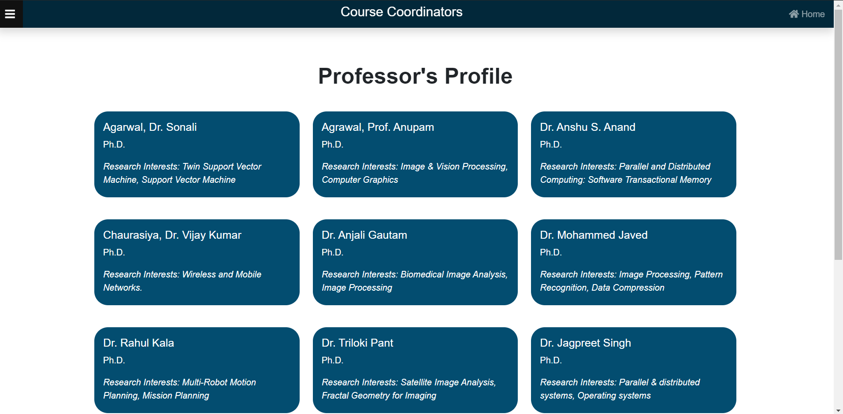
Course Coordinators

Slide 41
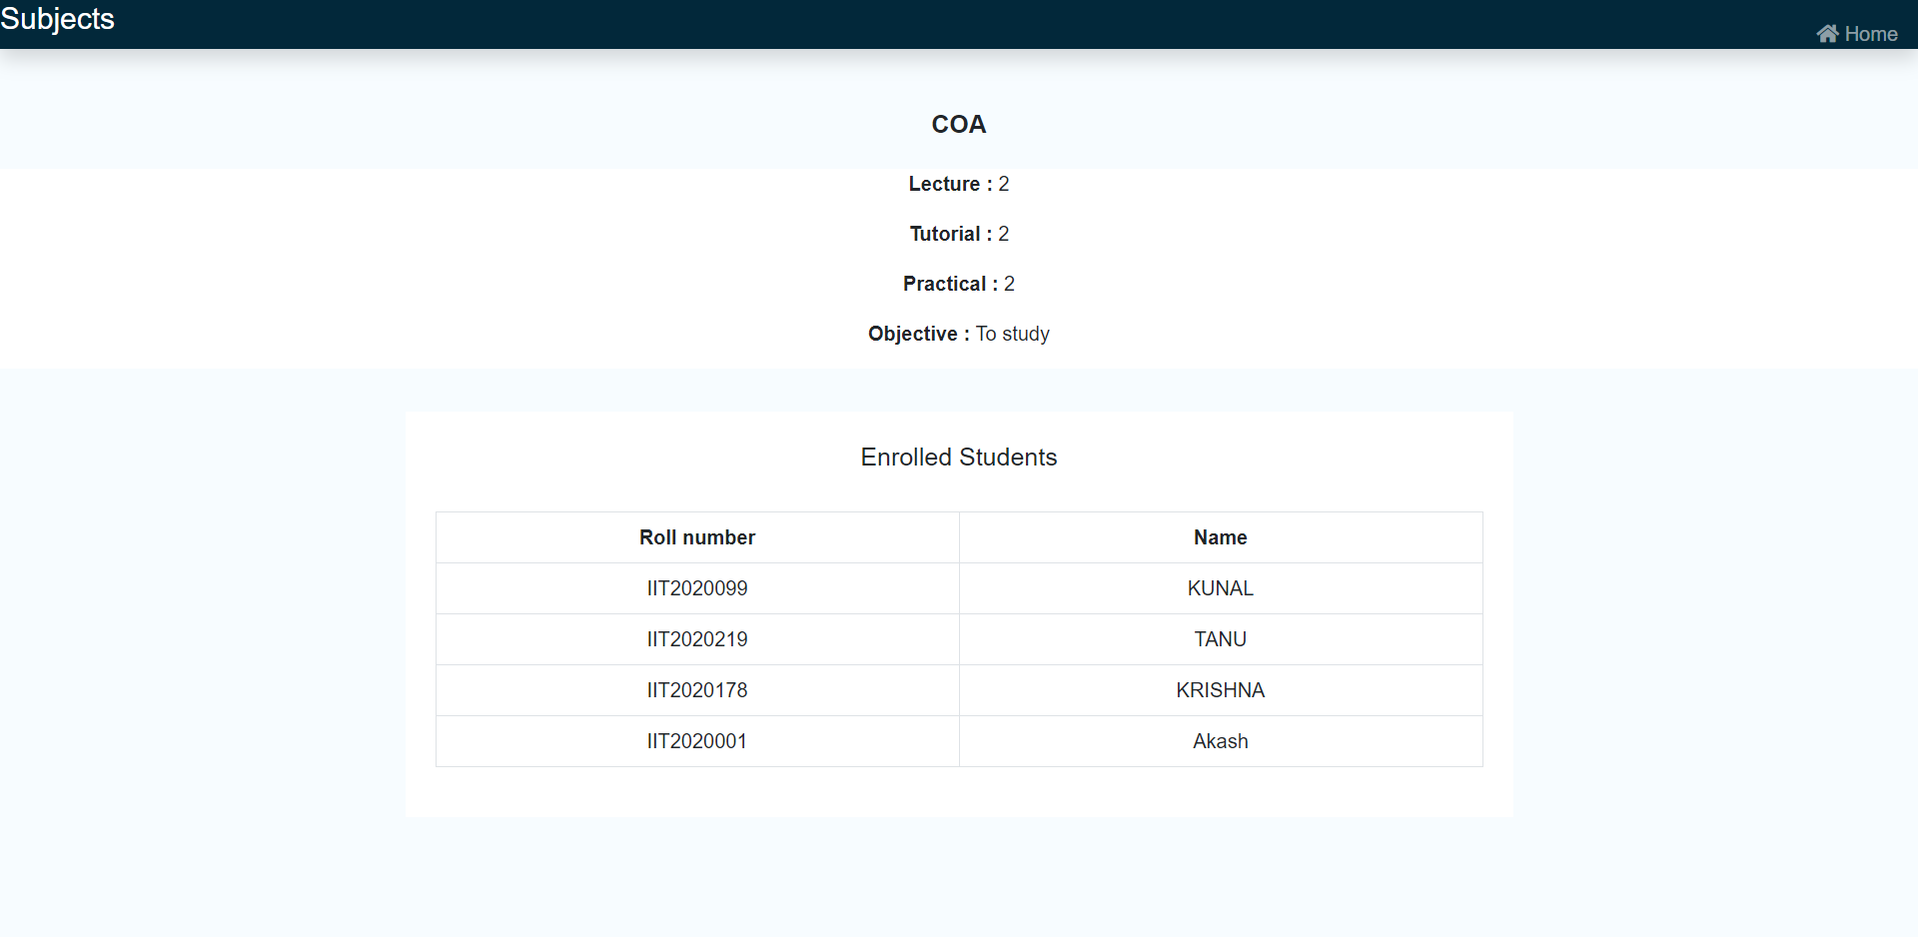
Search Subject

Slide 42

Thank you!

